Slide 1
Rating Prediction Report
Prepared by
SARTHAK GUPTA

Slide 2
Agenda
Introduction​
Problem Statement
Business Goal
Technical Requirement
Exploratory Data Analysis (EDA)
Data Cleaning
Visualization
Data Pre-Processing
Built Model
Saved Best Model
Summary​

Slide 3
Introduction
We have a client who has a website where people write different reviews for technical products. Now they are adding a new feature to their website i.e. The reviewer will have to add stars(rating) as well with the review. The rating is out 5 stars and it only has 5 options available: 1 star, 2 stars, 3 stars, 4 stars, 5 stars.
Now they want to predict ratings for the reviews which were written in the past and they don’t have a rating. So, we have to build an application which can predict the rating by seeing the review.
We have two phase:
1) Data Collection Phase: Scrape at least 20000 rows of data or more data from multiple websites.
2) Model Building Phase: After collecting the data, we need to build a machine learning model.
Before model building do all data preprocessing steps involving NLP. Try different models with different hyper parameters and select the best model.

Slide 4
Business Goal
People use multiple websites for shopping, like: Amazon, Flipkart etc. So, from these websites had to scrap all reviews and process them using Natural Language Processing to predict ratings for the reviews which were written in the past and they don’t have a rating by building an application (Machine Learning Project).

Slide 5
Technical Requirements
This project contains two phases:
1) Data Collection Phase: Scrape the reviews and ratings as data of two websites: Amazon and Flipkart
2) Model Building Phase: After collecting the data, we need to build a machine learning model. Before model building do all data preprocessing steps involving NLP. Try different models with different hyper parameters and select the best model.
Follow the complete life cycle of data science. Include all the steps like:
1. Data Cleaning
2. Exploratory Data Analysis
3. Data Preprocessing
4. Model Building
5. Model Evaluation
6. Selecting the best mode

Slide 6
EDA
Checked Top 5 rows of dataset
Checked Total Numbers of Rows and Column
Checked All Column Name
Checked Data Type of All Data
Checked for Null Values of both dataset
Checking if "-" values present in dataset or no
Checked total number of unique value
Checked Information about Data
Dropped irrelevant features
Handled NULL values
Handled duplicate values

Slide 7


Data Description
The dataset contains 53363 records (rows) and 4 features (columns).
After removal of irrelevant feature, and also after pre-processing, we remains with 49239 records (rows) and 4 features (columns).

Slide 8
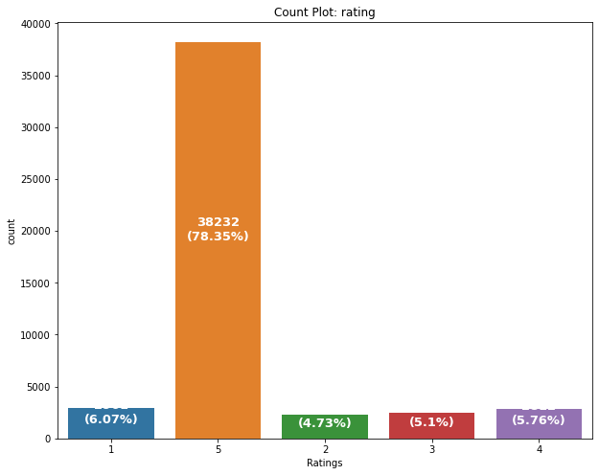
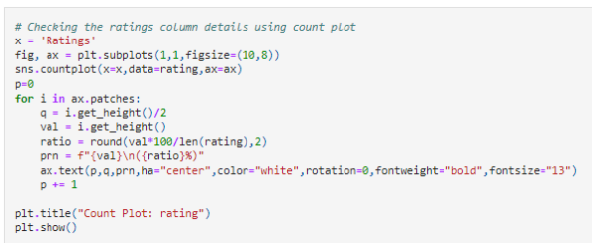

Data Visualization

Slide 9
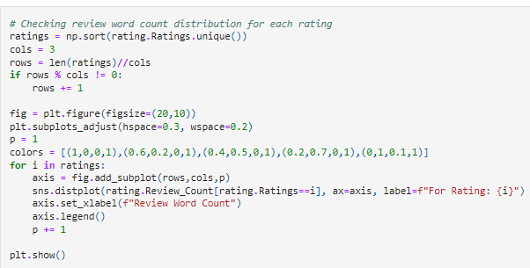
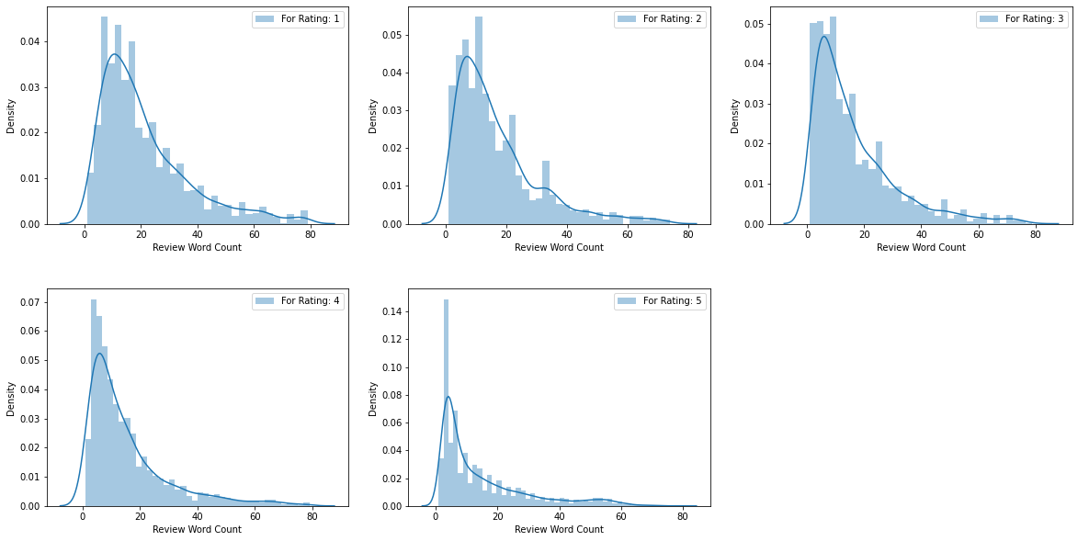
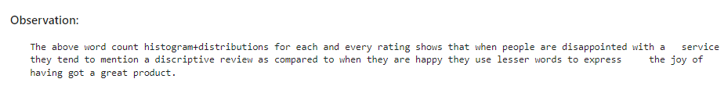
Data Visualization

Slide 10
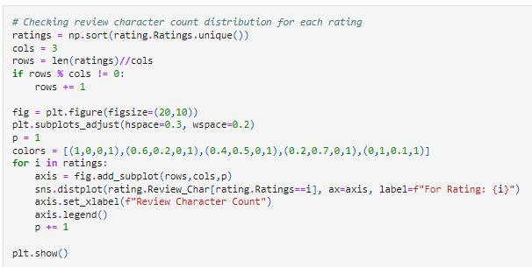
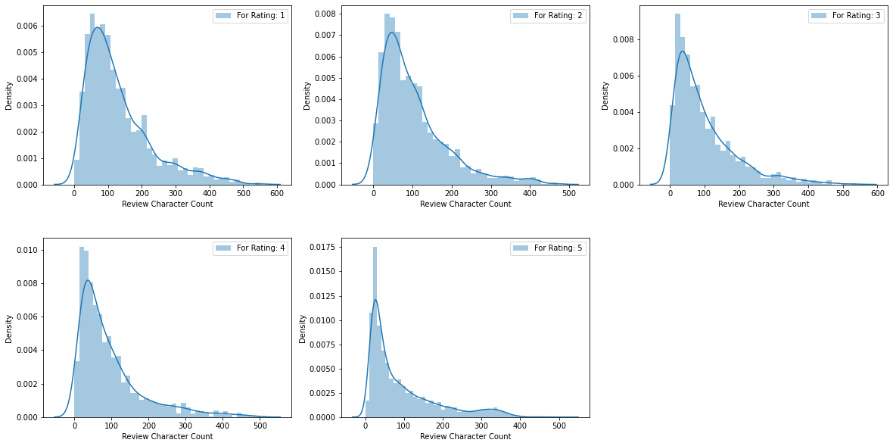
Data Visualization

Slide 11
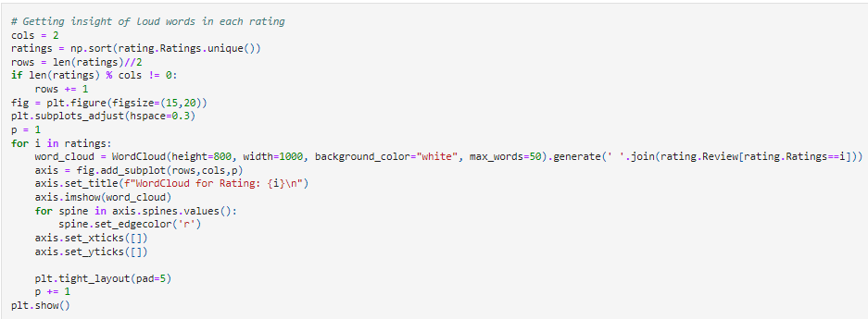
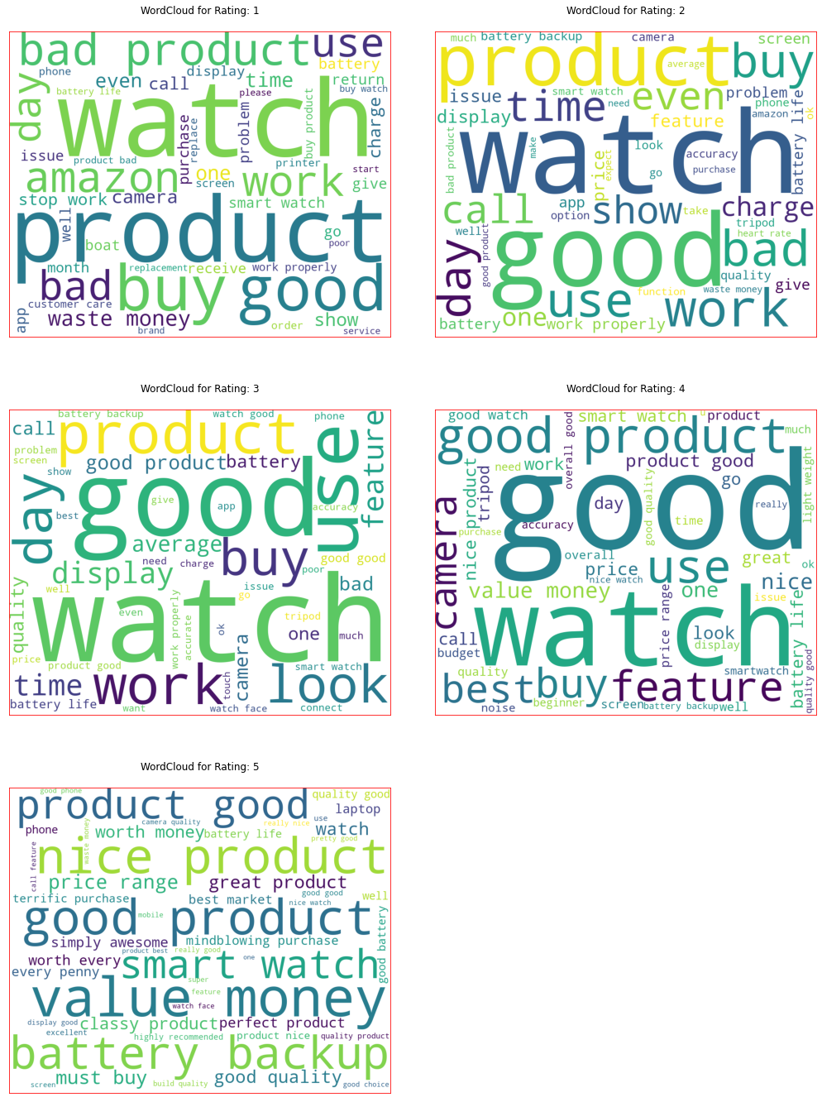
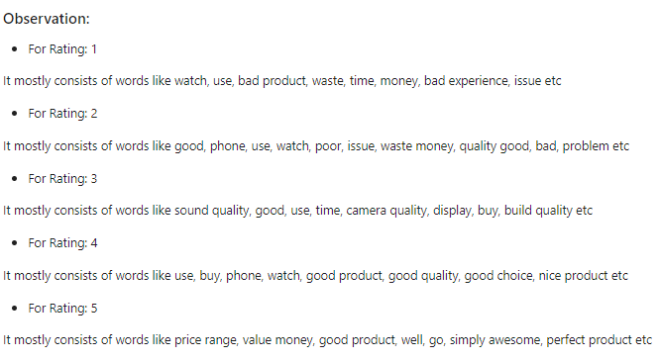
Data Visualization

Slide 12
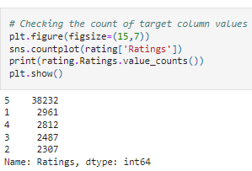
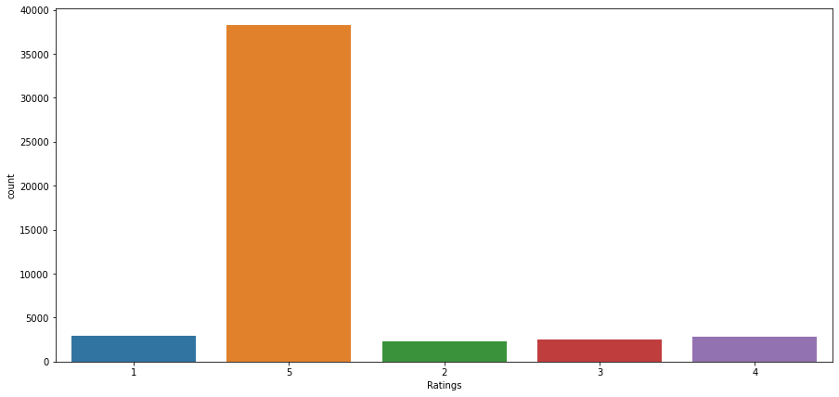
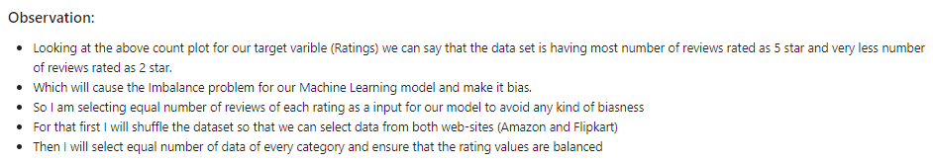
Data Visualization

Slide 13
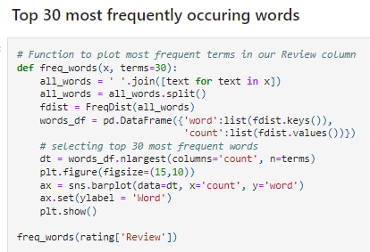
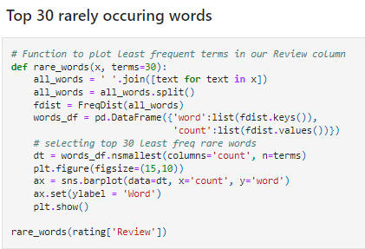
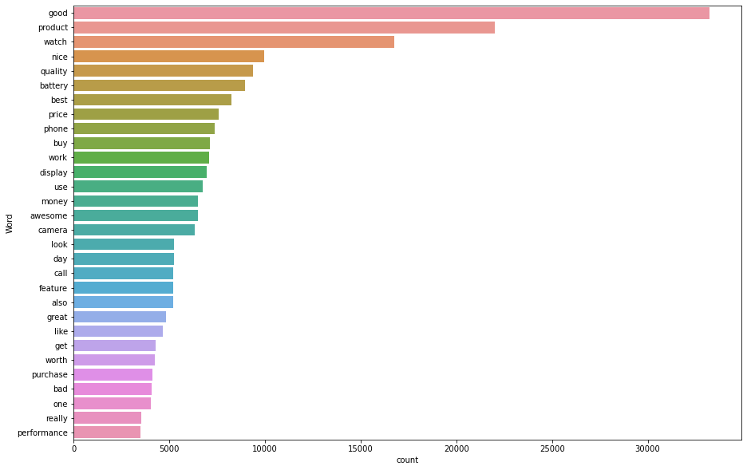
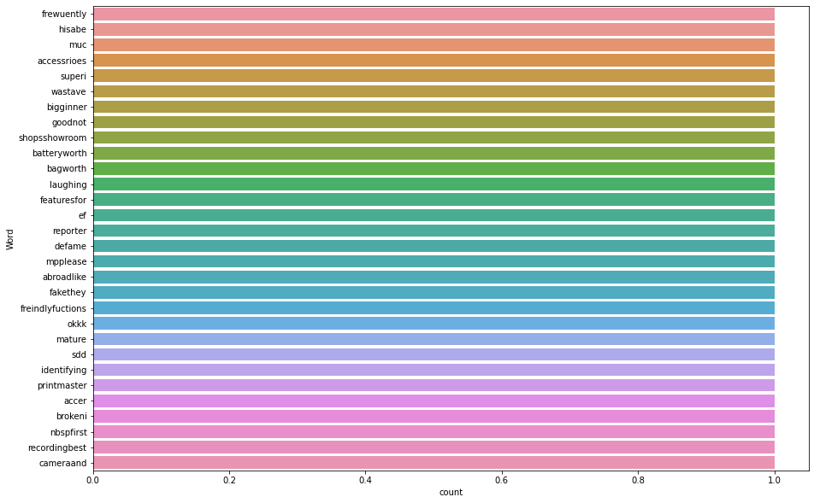
Data Visualization

Slide 14
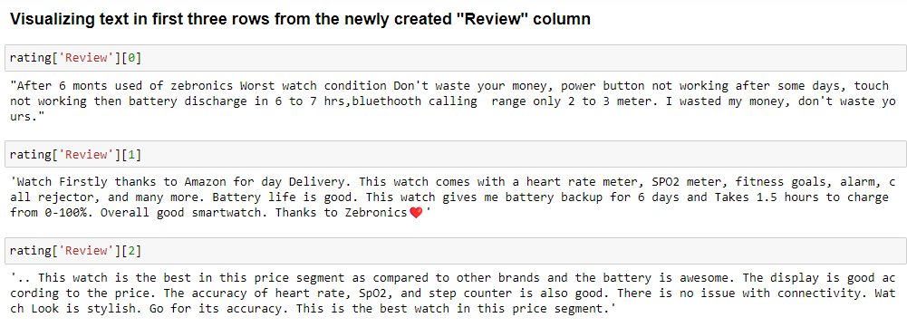
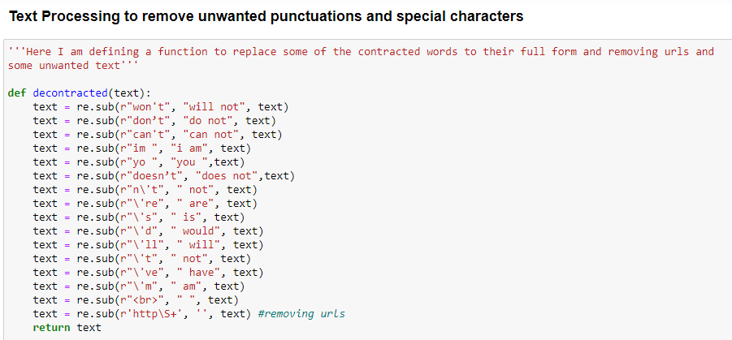
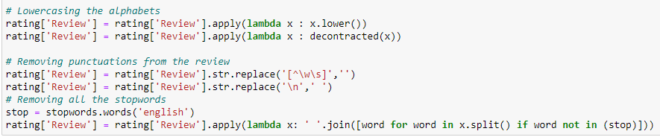
Data Pre-Processing

Slide 15


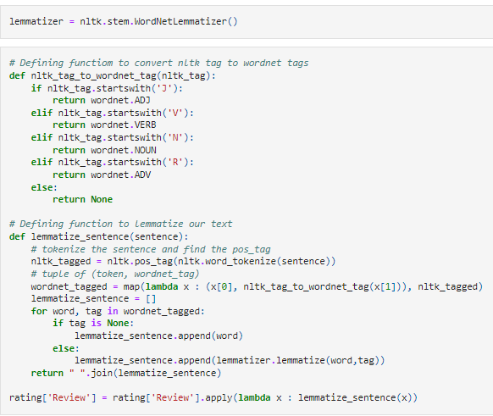
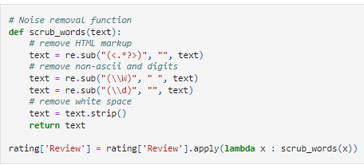
Data Pre-Processing

Slide 16


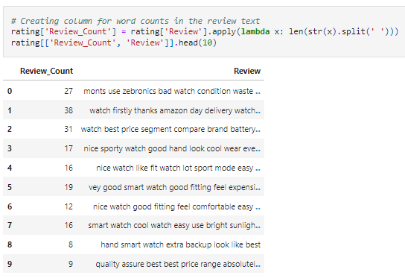
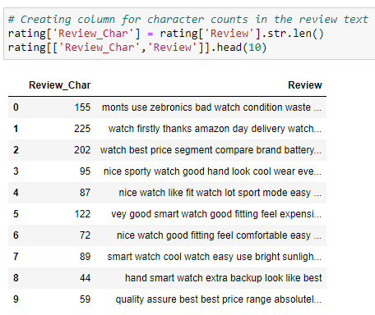
Data Pre-Processing

Slide 17
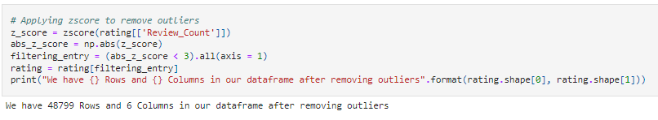
Removing Outliers

Slide 18
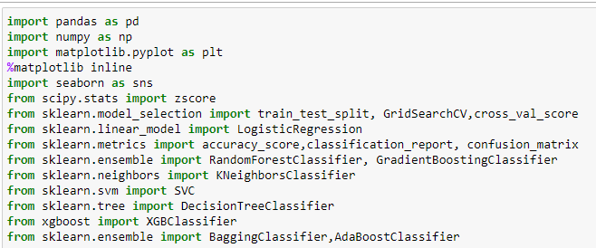
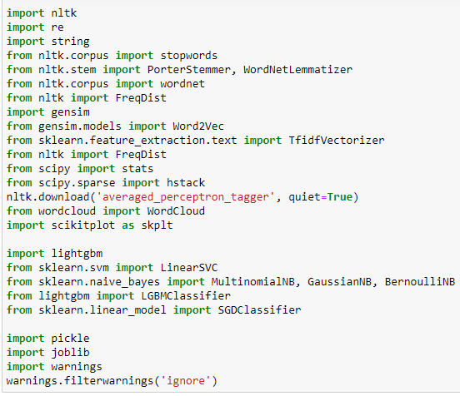
Libraries & Packages used

Slide 19
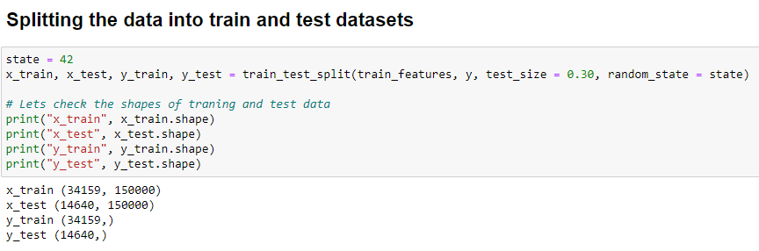
Creating Model

Slide 20
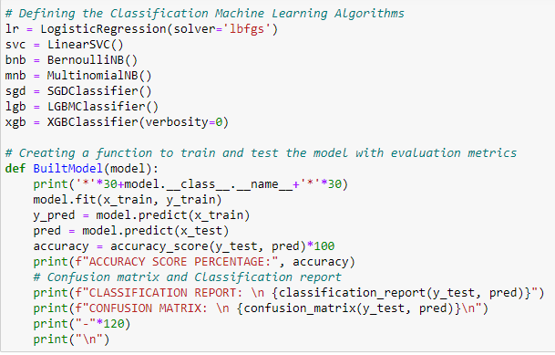

Creating Model

Slide 21
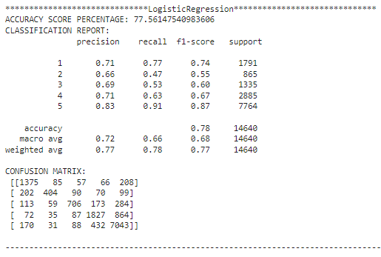
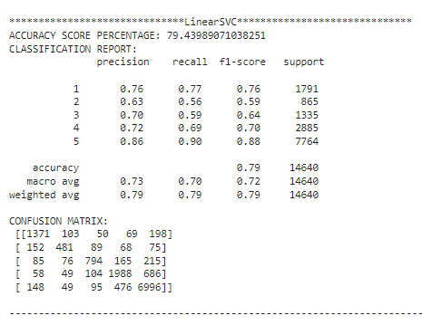
Creating Model

Slide 22
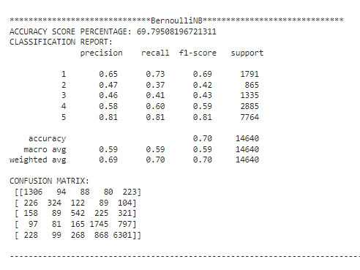
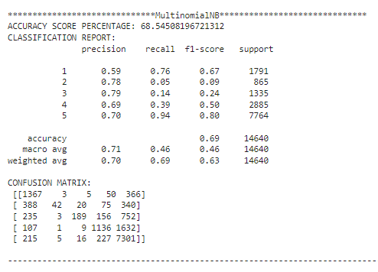
Creating Model

Slide 23
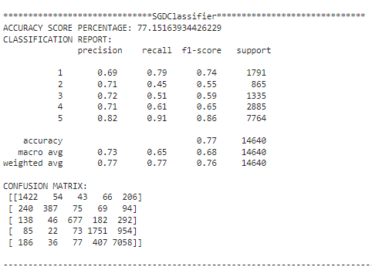
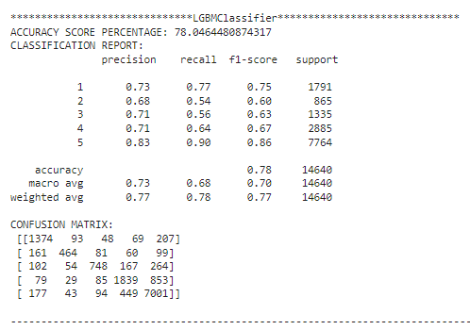
Creating Model

Slide 24
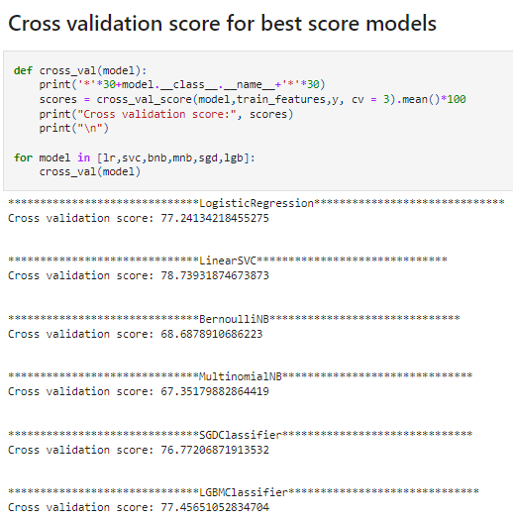
Cross Validation

Slide 25
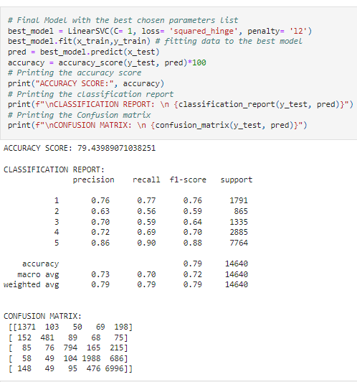
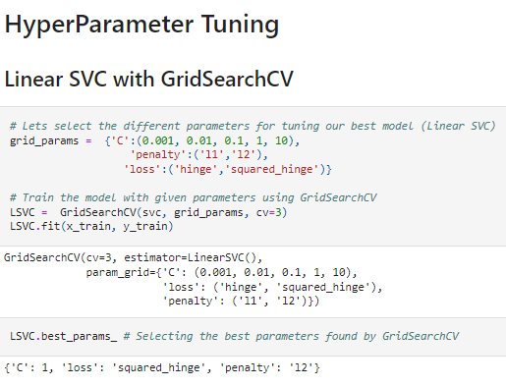
Hyper Parameter Tunning

Slide 26
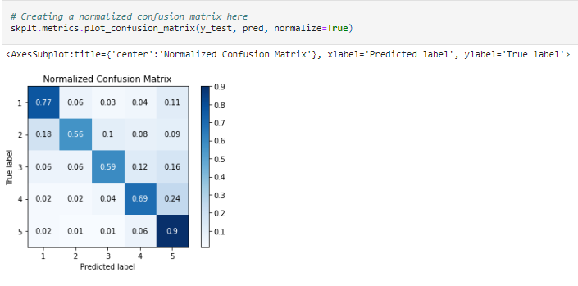
Hyper Parameter Tunning
26

Slide 27

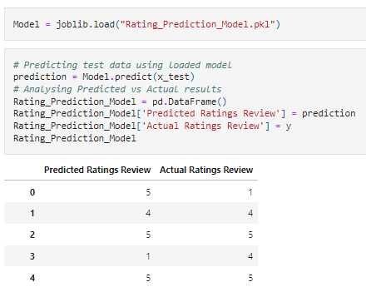
Final Steps
Saving the Model
Comparing Actual & Prediction

Slide 28

Final Steps
Saving the Model in CSV Format

Slide 29
Summary
In this project we have collected data of reviews and ratings for different products from amazon.in and flipkart.com. Then we have done different text processing for reviews column and chose equal number of texts from each rating class to eliminate problem of imbalance. By doing different EDA steps we have analyzed the text.
We have checked frequently occurring words in our data as well as rarely occurring words. After all these steps we have built function to train and test different algorithms and using various evaluation metrics we have selected Linear-SVC for our final model.
Finally, by doing hyperparameter tuning we got optimum parameters for our final model. And finally, we got improved accuracy score for our final model.

